Slide 1
Java Persistence API (JPA)
What is JPA?
Session & EntityManager
Configuration the persistence.xml
Mapping & Association

Slide 2
WHAT IS jpa?
Standard object/relation mapping
Persistence management interface of Java EE 5.0 platform (May 2006)
Java Persistence API
Hibernate
TopLink
Kodo (OpenJPA)
Java Application
ORM

Slide 3
Session & EntityManager
What is EntityManager?
Gateway to persistent entity, describes the management relation data
Enable queries, provides transaction
Standard of JPA, using to access database (persist, remove, merge, load, detach...)
What is Session?
Extension by Hibernate, more feature than JPA (save, saveOrUpdate, update, evict, ...)
Which one is the preferred?

Slide 4
Configuration the persistence.xml
3 way to configuration
OC4J Default Persistence Unit
Using JDBC vendor extensions
Specifying a Data Source

Slide 5
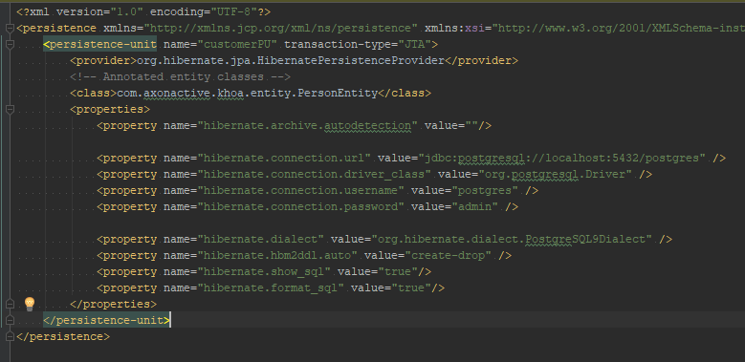
Configuration the persistence.xml
Using JDBC vendor extensions
<class> element: specifies an explicit list of classes.
<jar-file>: specifies one or more JAR files that will be searched for classes
hibernate.archive.autodetection : By default value class, hbm : auto scan Entities in package
hibernate.dialect: SQL syntax

Slide 6
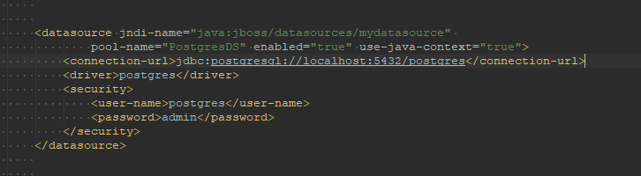
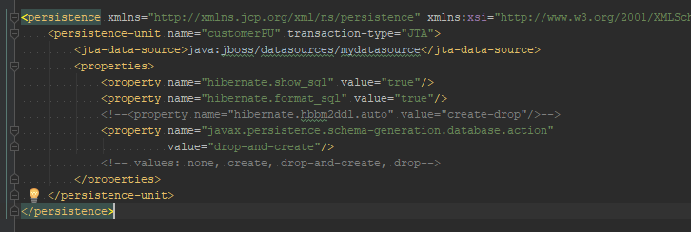
Configuration the persistence.xml
Specifying a Data Source

Slide 7
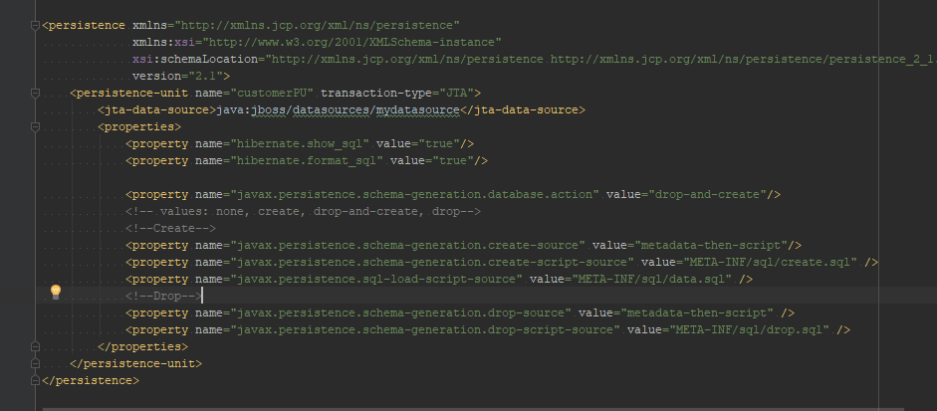
Configuration the persistence.xml
Schema action: none (default), create, drop-and-create, drop
Option: metadata, script, metadata-then-script or script-then-metadata.

Slide 8
Mapping & Association
Annotations: OneToMany, ManyToOne, OneToOne, ManyToMany, JoinColumn

Slide 9
Documents
Database schema creation: link
Configuration: link

Slide 10


